Slide 1

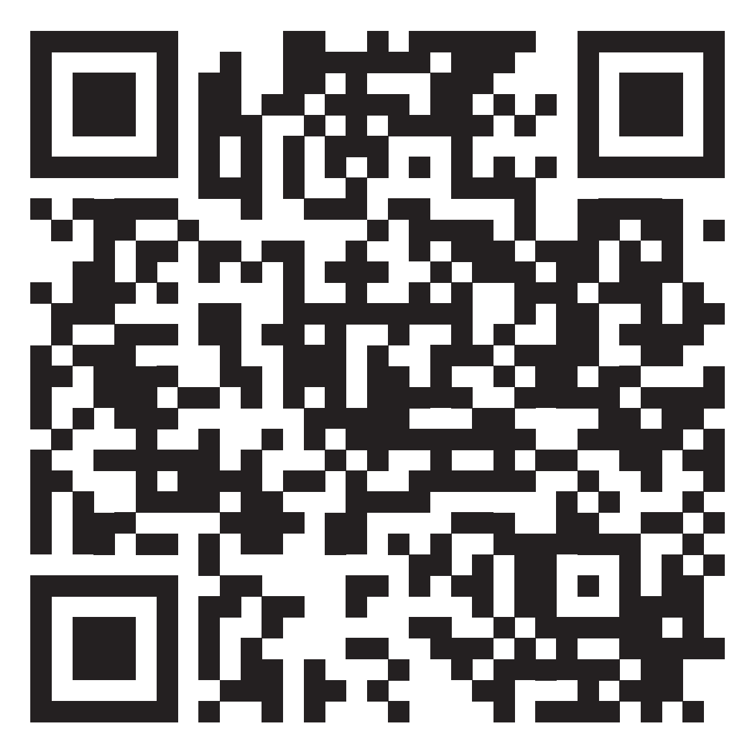
12 things your Architect and PM wish you'd stop doing on the project
Scan to enter drawing at CGI booth
The Architect: Heath Murphy
The Project Manager: Arin Heinselman

Slide 2




Agenda
Introducing: The Architect
Introducing: The PM
Show me the credentials
The mystic 12

Slide 3



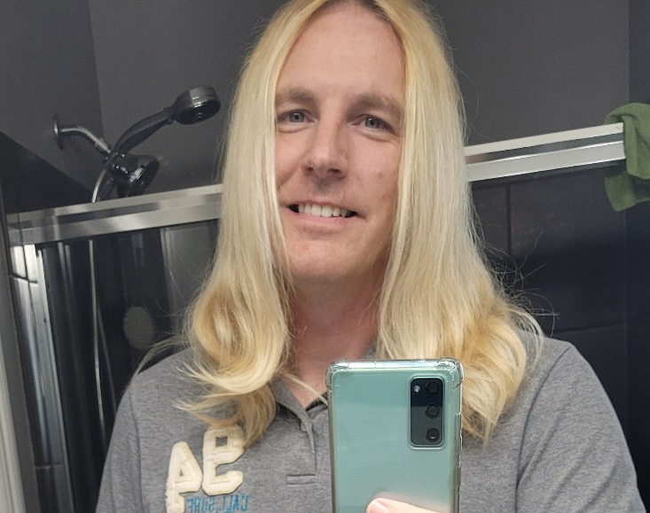



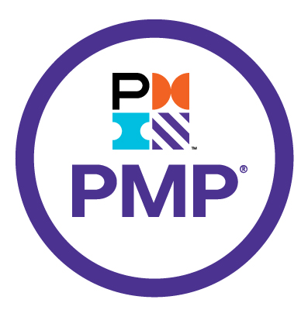
Heath Murphy
Director, Consulting Services
I’m from Columbus, OH and therefore by state law I bleed Scarlet and Grey… O H!
This was my COVID hair… and I bet you have a story as well?? It’s real, I promise.
I have an unhealthy fascination with Pumpkin Ales… when those aren’t in season, I’ll take the dankest Imperial/Double IPA I can find.

Slide 4
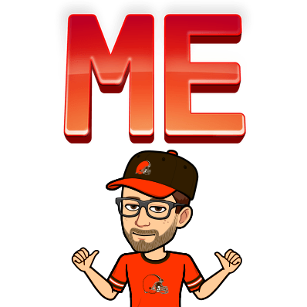




Arin Heinselman
Married with three young kids (8,5,1) and a old dog.
Life-long Browns fan.
**this is not our year**
Life-long Buckeyes fan.
**it’s ALWAYS our year**
Director, Consulting Services
Program and Project Manager with 15+ years of experience across all sizes and types of projects – waterfall, agile, some homebrewed method, etc.
Nine years with CGI having worked with at over a dozen different clients.
From the Columbus, OH area but spent over six years in Nashville, TN working for the State of TN.

Slide 5
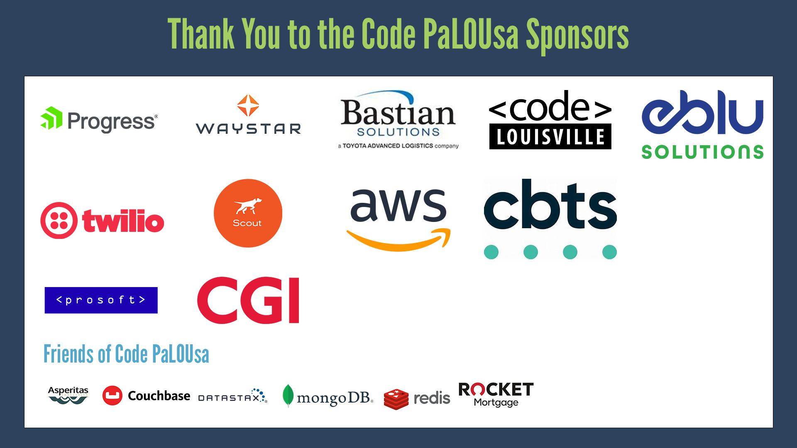

Slide 6
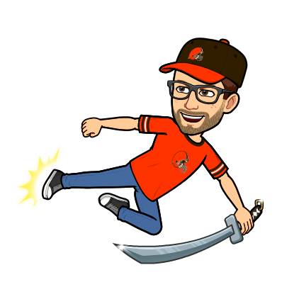

Show me the creds battle scars!
Experience
Project Success
Mistakes
35 Combined Years
Currently manage multiple $$$ projects
Oh yeah, we’ve made them
Means we’re old?
So we’re important now
Maybe some more here too
Is this a cycle? We start again
Been there done that
Through trial and error
More mistakes
And lots of certifications
We’re good… like this much good

Slide 7



Here are the top 12 things
The mystic 12

Slide 8


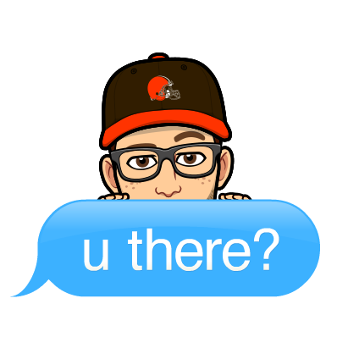
Yo Dawg, speak up
The Architect
Be active, participate, Be there

Slide 9
Stop: Sitting on the sidelines

Slide 10

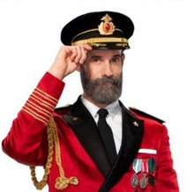

“Great ideas only get implemented when they’re shared”
- Words of obvious wisdom by us
12 things your Architect and PM wish you'd stop doing on the project

Slide 11

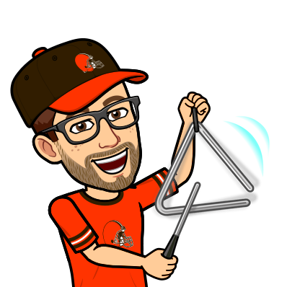
Come to meetings prepared
Planning meetings, demos, retrospectives… You know agenda. Come prepared and ready to share ideas. Don’t be a passive participant.
Proactive Communication
See something, say something
Is there a better way to write that code or test that feature? Say something, don’t wait.

Slide 12
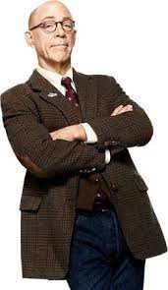
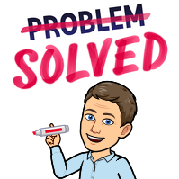
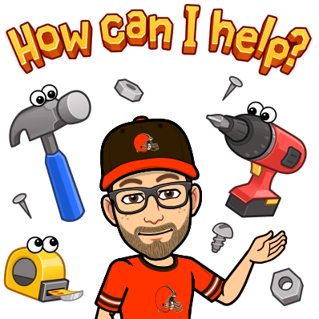
If you have a problem yo i’ll we’ll solve it…
But only if we know about it
“We know a thing or two because we’ve seen a thing or two.”
- That one guy from the commercial

Slide 13

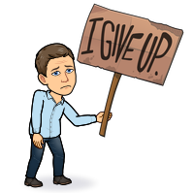
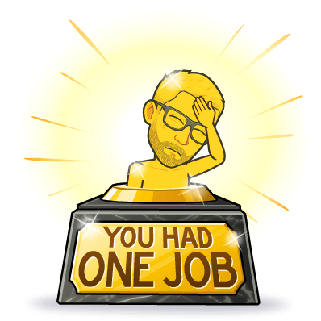
If you’re going to fail
The Architect
At least do it fast

Slide 14
Stop: Spinning your wheels

Slide 15
Pop Quiz: How long should you wait before asking the architect a question about the code/user story?
0 min
20-30 min
1-2 hrs
NaN
Don’t Even Start
Before getting approval.
Give it a few Google searches
The answer is here somewhere.
A solid run
Give it a solid go but don’t waste time. Fail early and fast if needed.
Infinity
I will figure this OUT!

Slide 16
The Architect Says
The PM Says
Don’t spin your wheels. We’ve solved this before and I can show you where in the code.
Great timing, this is a difficult part of the code. Can I pair you with Sam since he knows it best?
You wasted how much time on that? We’ve lost an entire day now.
Ask but don’t be a drag on my Sr resources.
Document what you learn for others on the project.
Ok, did you even Google this?
Verdict:
Don’t waste time, ask quickly. My job is to ensure your success.
Verdict:
Ok, ok… ask but be efficient. My job is to ensure project success

Slide 17

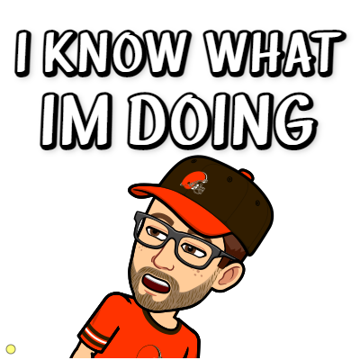
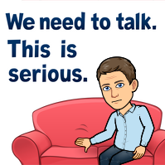
Go with your gut
The PM
Who needs to capture the datas anyways?

Slide 18
Stop: Making decisions without data

Slide 19
Empirical Process Control Theory
I can tell you what I can do based on what I’ve done already
Scrum is founded on empirical process control theory, or empiricism
Asserts that knowledge comes from experience and making decisions based on what is known
Scrum employs an iterative, incremental approach to optimize predictability and control risk
i.e. measure what has been done, not predict what might be done
Traditional Critical Path project management techniques (such as Waterfall) utilize Earned Value Management concepts which track actuals against a pre-defined estimate
12 things your Architect and PM wish you'd stop doing on the project
19
12 things your Architect and PM wish you'd stop doing on the project
Notes:
Transparency
Significant aspects of the process must be visible to those responsible for the outcome.
Transparency requires those aspects be defined by a common standard so observers share a common understanding of what is being seen.
For example:
A common language referring to the process must be shared by all participants; and,
Those performing the work and those accepting the work product must share a common definition of “Done”.
Inspection
Scrum users must frequently inspect Scrum artifacts and progress toward a Sprint Goal to detect undesirable variances.
Their inspection should not be so frequent that inspection gets in the way of the work.
Inspections are most beneficial when diligently performed by skilled inspectors at the point of work.
Adaptation
If an inspector determines that one or more aspects of a process deviate outside acceptable limits, and that the resulting product will be unacceptable, the process or the material being processed must be adjusted.
An adjustment must be made as soon as possible to minimize further deviation.
Scrum prescribes four formal events for inspection and adaptation, as described in the Scrum Events section of this document:
Sprint Planning
Daily Scrum
Sprint Review
Sprint Retrospective

Slide 20


Slide 21
How’s my project doing?
The scenario:
10 Week project.
We’re building 10 web pages.
We’re on week number 5 but we’ve only completed a single web page.
Bonus:
What’s an example of using data to track an Agile project?
Notes:
Answer: Not enough information. Progress status is relative to “the plan” and we need to use the data we have to define how we’re tracking against that plan.
Bonus: Burndown, velociy
Moral = rely on the data to tell the story

Slide 22



Talk with who??
The Architect
They don’t even know sql, they’d never understand me

Slide 23
Stop: Letting your PM & SA do all the talking. Do build meaningful relationships with your stakeholders and team.

Slide 24
Learn their language… understand them
Their Role
What are they responsible for in their current role?
Goals
What are they trying to achieve with the project?
Motivators
What makes them get up each day and come to work? How do they measure a successful day?
Hobbies
Yes, you can talk non-work at work within reason.
How do they view you?
Are you just a developer, just a consultant? Become more than what you are and you’ll achieve results.

Slide 25
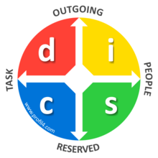

Leverage DISC
A work-focused personality self-assessment tool
Dominance: active use of force to overcome resistance in the environment
Inducement: use of charm in order to deal with obstacles
Submission: warm and voluntary acceptance of the need to fulfill a request
Compliance: fearful adjustment to a superior force

Slide 26
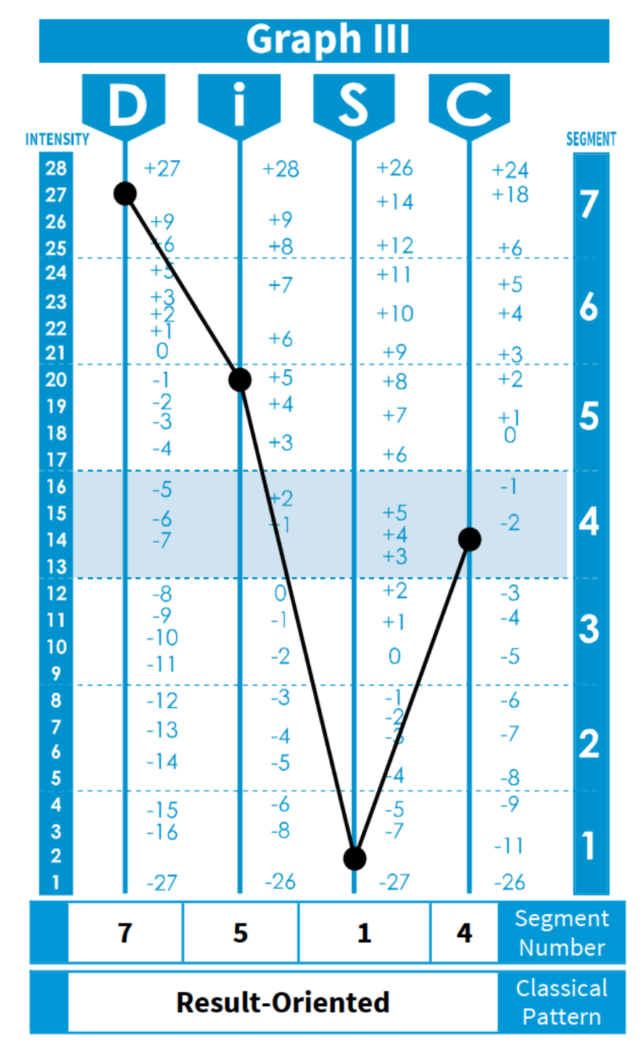
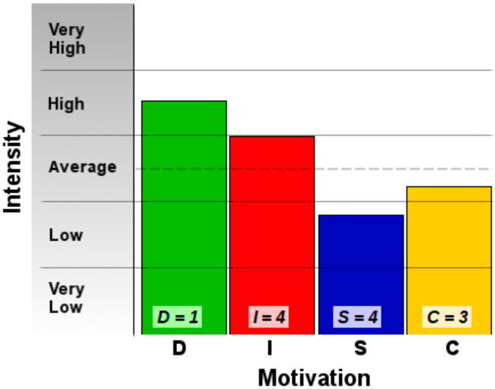
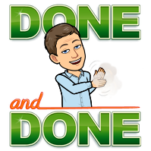
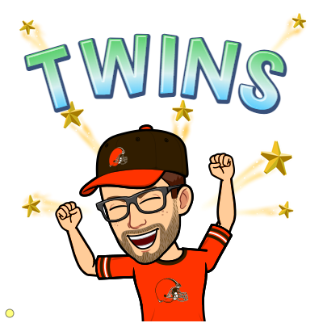
The Architect’s DISC
The PM’s DISC

Slide 27



Look, there is a shiny!
The Architect
It’s down this rabbit hole

Slide 28
Stop: Going the wrong direction. Take time to pause before charging off to solve the problem incorrectly.

Slide 29
How to escape a Rabbit Hole
01
02
03
Has this been done before?
Find other areas of the codebase where this may have a pattern to follow.
Rubber Duck It
Phrase/technique coined to articulate through your problem in words (not code) to another.
Fail Fast
Covered earlier, talk to your architect or PM about approach. Better yet, bring in the BA and product owner.
06
05
04
How’s that estimate?
Are you going to finish within the estimated time? If you know you’re going way over then STOP. Go back to 1.
Too many “news”?
Are you running into too many new concepts with your feature? Rabbit Holes are known to be riddled with new concepts that need to be invented the deeper you go.
Implement Arch Calls
Schedule afternoon “architecture calls.” Goal is to talk shop and spread ideas on approach.

Slide 30

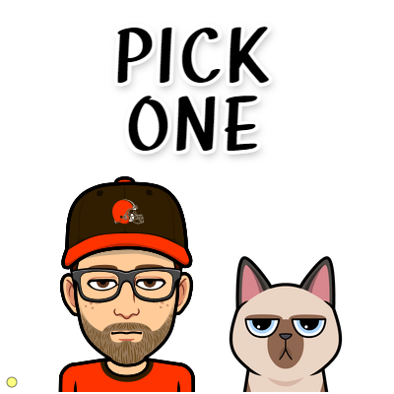

Mix up your methodology!
The PM
Scrummerfall, Waterban, incremental-delivery-of-random-scope-by-firm-deadline

Slide 31
Stop: Thinking you know better or your situation is different. These methods are called “industry standard” for a reason: they’re tried and true, and they work.

Slide 32
The Iron Triangle “Triple Constraint”
Scope
Cost
Time
Waterfall “pins” scope by mandating all requirements are gathered up front - this gives a PM flexibility to adjust Cost/Time to meet the projects needs.
Agile on the other hand “pins” either Cost and/or Time depending on the project and allows the team to build the best product that fits the projects needs.
For a successful project you will need flexibility and you cannot “pin” all three main constraints!
"No battle plan ever survives contact with the enemy."
- Helmuth von Moltke the Elder
Notes:
“Everyone has a plan until they get punched in the mouth.” - Iron Mike Tyson

Slide 33

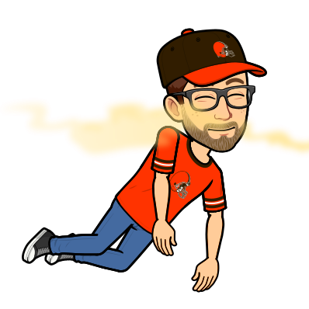

Old Dog, Old Tricks
The PM
Why adapt? My way of doing things has never let me down yet

Slide 34
Stop: Fighting change and being resistant to new ideas.

Slide 35
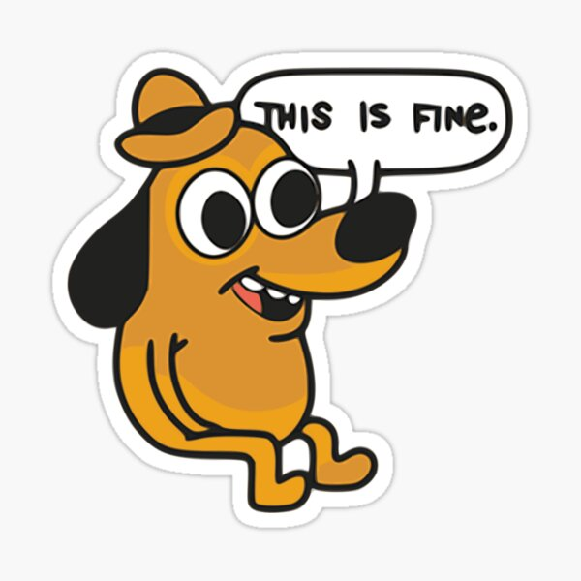

CONSIDER:
Each new project is a special snowflake with individual goals and constraints.
People, process, and technology are continually evolving.
To be continue to be successful in a changing world, we must keep an open mind that we are ALWAYS able to improve.
ASK:
Do I think or act this way based on 1st principles?
What information or data do I need to see to change my mind or behavior?

Slide 36

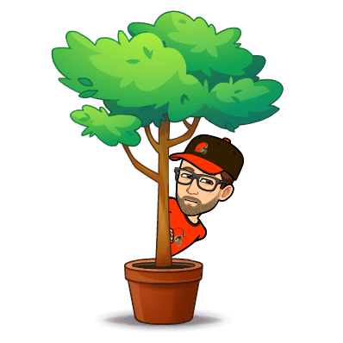
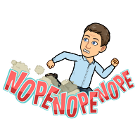
Not It!
The Architect
The last one to touch it owns it… so I’ll just avoid it

Slide 37
Stop: Avoiding ownership. The PM and Architect don’t want to assign everything. Take initiative.

Slide 38
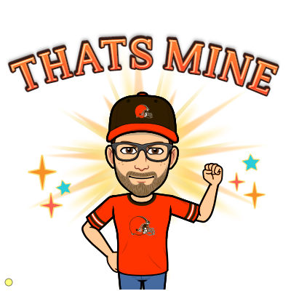

Ownership
&
Initiative
Self Assign
Allow the team to self assign tasks. Do not practice strict delegation.
Communicate at Junctions
Don’t assume the BA will handle all coordination of non-code related tasks.
Follow Through
Don’t pass the buck or throw the code over the wall. Own the feature soup to nuts.
Take Chances
Grab the difficult tasks, own it all the way to production. Be the hero!

Slide 39

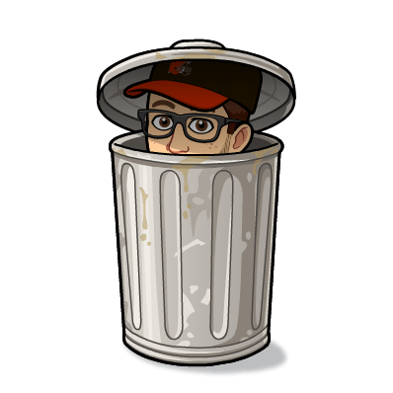
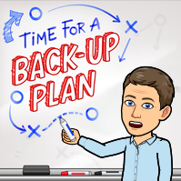
Plan, Schmlan
The PM
Drop the playbook at the first sign of distress and let's figure this out on the fly

Slide 40
Stop: Being reactive. Instead, be proactive to anticipate where you may stumble and plan accordingly.

Slide 41
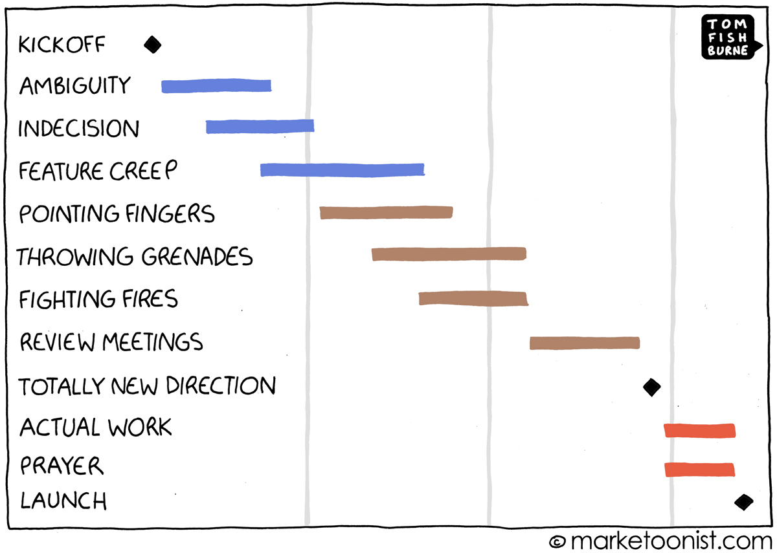
Notes:
We’ve all see these projects: starts off without a solid plan, goes south, then CRUNCH TIME to superman it over the finish.
Plan the work – work the plan.

Slide 42
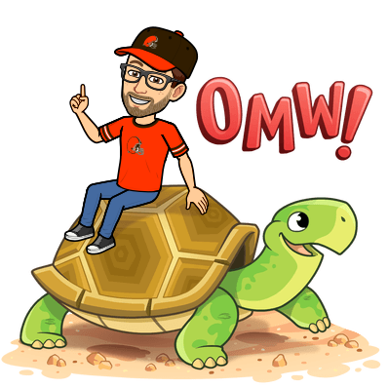
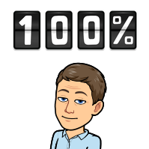
Keep things vague
10
The PM
If it's 80% done then we're almost there, right?

Slide 43
Stop: Avoiding Facts. Communicate to your stakeholders known truths and avoid inserting your opinion.

Slide 44

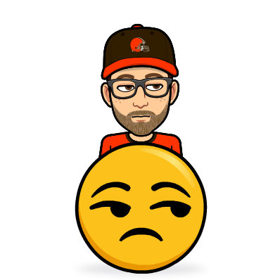
DON’T say these….
…to your Project Manager
DO say these….
I’m almost there.
It’s about 80% done.
It will be ready in just a bit.
…to your Solution Architect
…to your Project Manager
It worked on my machine.
There be dragons down there.
Pretty sure I tested that use case.
The task is done.
I’m on track.
There’s more work here than we planned, we need to adjust our expectations.
…to your Solution Architect
I’ll confirm this works in QA and get it to production
I think we can rework this area of code. Let me schedule a quick call.
I confirmed it meets all acceptance criteria and it passes my sniff test

Slide 45
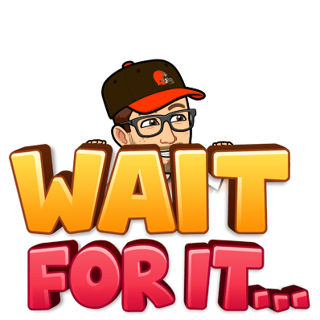

The Hollywood Principle Don’t call us, well call you…
11
The PM
I'll get you when I'm done so you can see what I've got

Slide 46
Stop: Working in a silo. Seek feedback early and often.

Slide 47
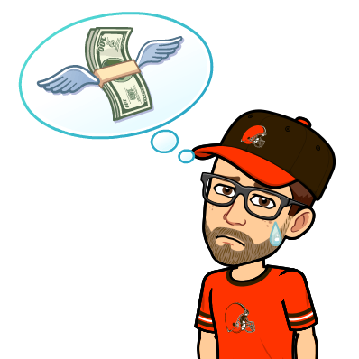

Team Work Makes the Dream Work
Early Chage is Cheap
Your perspective is limited. Seek feedback from others to see the things you may be missing.
As we discussed before, shift left and fail fast. The earlier we identify a change is needed the easier it is to work with stakeholders to incorporate.
Get Some Wins!
Understand the Goal
Showing off your hard work early allows stakholders to build confidence in you and the team.
Having a better understanding of the value our project delivers to the customer enables us to get outside of our individual silo and work more closely with others.

Slide 48
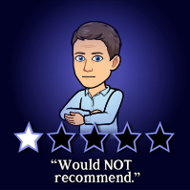
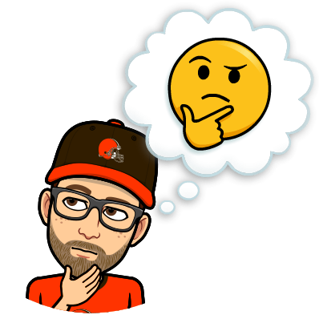
Did you even test that before pushing?
12
The Architect
PR (pull request) code churn is a killer

Slide 49
Stop: Moving fast irresponsibly. The Churn it causes creates more bottlenecks than the additional upfront speed offers.

Slide 50

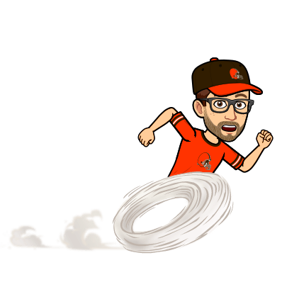
Moving at the speed of responsibility
Definition of Done
Agree what Done means and abide by the rules. No shortcuts!
Three Amigos
Mini demo of completed stories with the BA + QA. Could even include the Product Owner.
Automate PRs
Build rules into the PR system. Require peer review, unit tests, etc. Don’t allow exceptions.
Run the code locally
Do I even need to include this? Don’t check in a change without running locally developers!

Slide 51
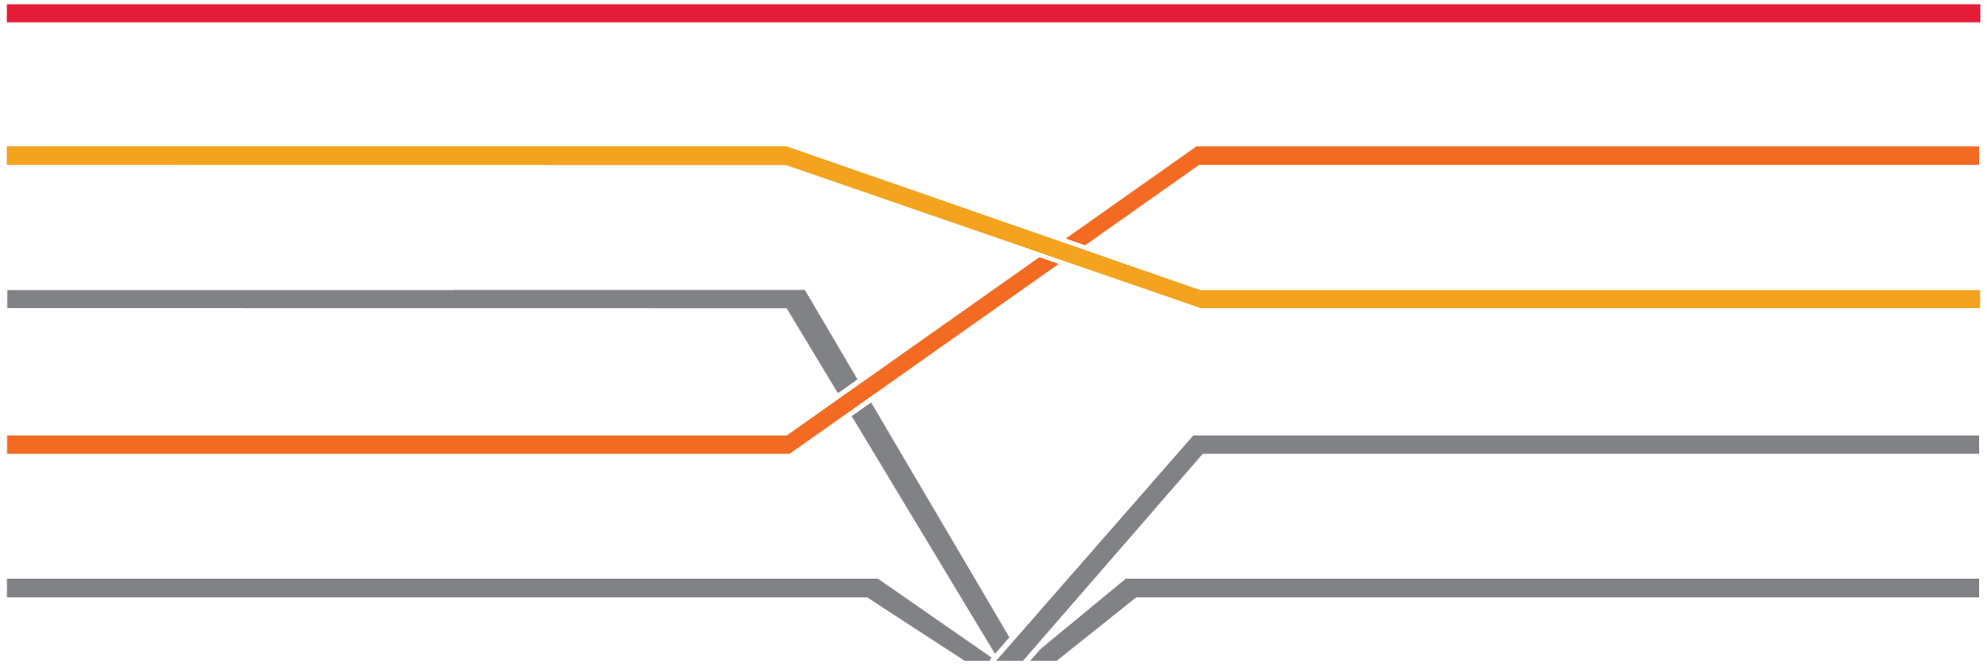

The Mystic 12
Stop: Sitting on the sidelines.
Stop: Fighting change and being resistant to new ideas.
1
7
Stop: Spinning your wheels.
Stop: Avoiding ownership. The PM and Architect don’t want to assign everything. Take initiative
2
8
Stop: Making decisions without data.
Stop: Being reactive. Instead, be proactive to anticipate where you may stumble and plan accordingly.
3
9
Stop: Letting your PM & SA do all the talking. Do: Build meaningful relationships.
Stop: Avoiding Facts. Communicate to your stakeholders known truths and avoid inserting your opinion.
4
10
Stop: Going the wrong direction. Take time to pause before charging off to solve the problem incorrectly.
Stop: Working in a silo. Seek feedback early and often.
5
11
Stop: Thinking you know better or your situation is different. These methods are called “industry standard” for a reason.
Stop: Moving fast irresponsibly. The Churn it causes creates more bottlenecks than the additional upfront speed offers.
6
12

Slide 52




THANK YOU
The Architect:
HEATH MURPHY
The PM:
ARIN HEINSELMAN
https://www.linkedin.com/in/heath-murphy-pmp-mcsd-39960542/
https://www.linkedin.com/in/arinheinselman/
https://www.cgi.com
Insights you can act on
12 things your Architect and PM wish you'd stop doing on the project

Slide 53


